Slide 1
CSE-4606 (Computer Networks Lab) Lab:1
Computer Science and Engineering Department
Islamic University of Technology

Slide 2
Lecture Outline
First session
Introduction to Simulation
NS-2 fundamentals
NS-2 Component
Second session
Introducing TCL
Third session
Working with NS-2

Slide 3
Simulation
Simulation is the imitation of the operation of a real-world process or system over time.
Simulation requires:
a model to be developed
The model represents the system itself, whereas the simulation represents the operation of the system over time.

Slide 4
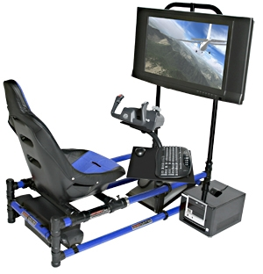
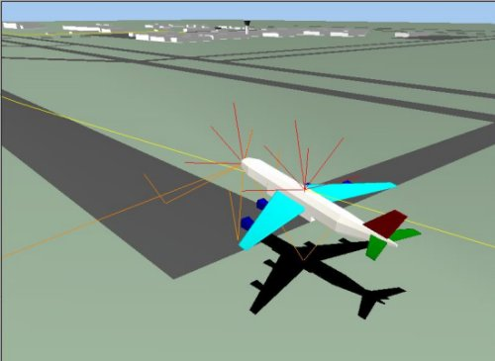
Flight Simulator

Slide 5
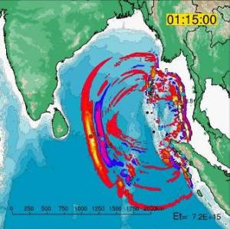
Geophysicist Creates Computer Simulation of Indian Ocean Tsunami
Sophisticated computational techniques to simulate the tsunami

Slide 6
Network Simulation
network simulation is a technique where a program models the behavior of a network
either by calculating the interaction between the different network entities (hosts/routers, data links, packets, etc.) using mathematical formulas
Or actually capturing and playing back observations from a production network.

Slide 7
Network Simulator
A network simulator is a piece of software or hardware that predicts the behavior of a network, without an actual network being present.
A network simulator is a software program that imitates the working of a computer network.

Slide 8
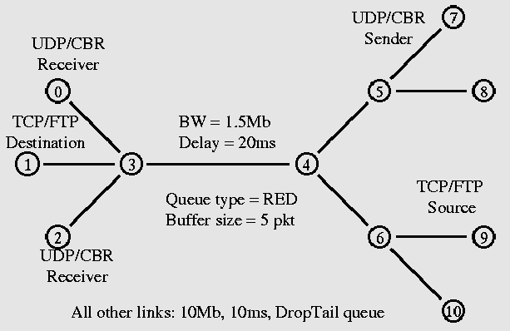
Network Simulator

Slide 9
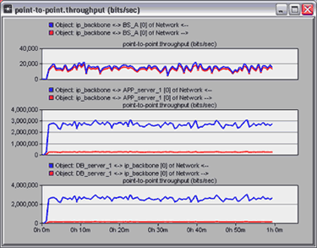
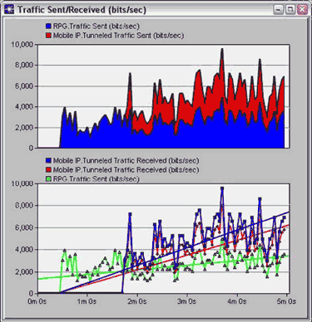
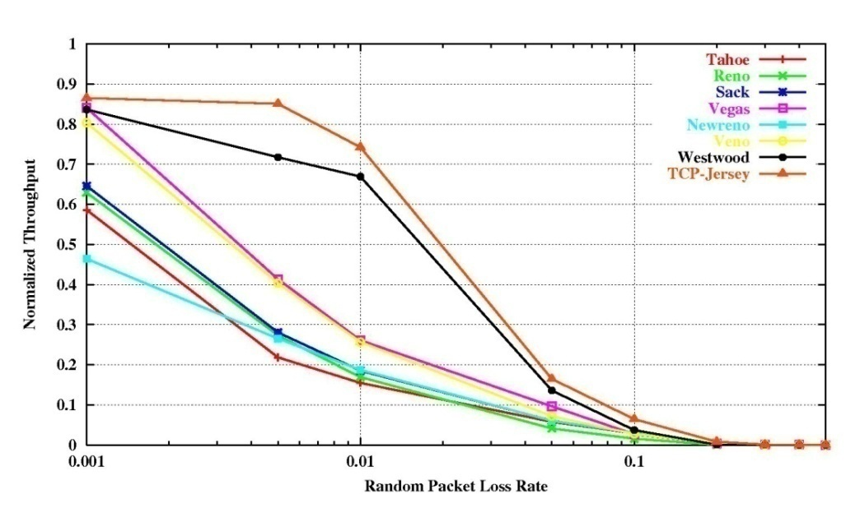
Network Simulation Result Analysis

Slide 10
NS-2
A discrete event simulator
Focused on modeling network protocols
Wired, wireless, satellite
TCP, UDP, multicast, unicast
Web, telnet, ftp
Ad hoc routing, sensor networks
Infrastructure: stats, tracing, error models, etc

Slide 11
NS-2 Goals
Support networking research and education
Protocol design, traffic studies, etc
Protocol comparison
Provide a collaborative environment
Freely distributed, open source
Share code, protocols, models, etc
Allow easy comparison of similar protocols
Increase confidence in results
More people look at models in more situations
Experts develop models
Multiple levels of detail in one simulator

Slide 12
Discrete Event Simulation
Model world as events
Simulator has list of events
Process: take next one, run it, until done
Each event happens in an instant of virtual (simulated) time, but takes an arbitrary amount of real time
NS-2 uses simple model: single thread of control
no locking or race conditions to worry about (very easy)

Slide 13
Discrete Event Examples
Consider two nodes
on an Ethernet:
simple
queuing
model:
t=1, A enqueues pkt on LAN
t=1.01, LAN dequeues pkt
and triggers B
A
B
t=1.0: A sends pkt to NIC
A’s NIC starts carrier sense
t=1.005: A’s NIC concludes cs,
starts tx
t=1.006: B’s NIC begins reciving pkt
t=1.01: B’s NIC concludes pkt
B’s NIC passes pkt to app
detailed
CSMA/CD
model:

Slide 14
“NS-2” Components
NS-2, the simulator itself
Nam, the network animator
Visualize ns (or other) output
Nam editor: GUI interface to generate ns scripts
Pre-processing:
Traffic and topology generators
Post-processing:
Simple trace analysis, often in Awk, Perl, or Tcl

Slide 15
Using NS-2
Problem
Result
analysis
Simulation
model
Modify
ns
Setup/run
simulation
with ns

Slide 16
Class Hierarchy
TclObject
NsObject
Network
Interface
Connector
Classifier
Queue
Delay
Agent
Trace
AddrClassifier
McastClasifier
DropTail
RED
TCP
Enq
Dnq
Drop
Reno
SACK

Slide 17
Otcl and C++: The Duality
C++
C++/OTcl
split objects
otcl
OTcl (object variant of Tcl) and C++ share class hierarchy
TclCL is glue library that makes it easy to share functions, variables, etc

Slide 18
tcl Interpreter With Extents
Event
Scheduler
ns-2
tclcl
Network
Component
otcl
tcl
otcl: Object-oriented support
tclcl: C++ and otcl linkage
Discrete event scheduler
Data network (the Internet) components

Slide 19
TCL

Slide 20
NS programming
Create the event scheduler
Turn on tracing
Create network
Setup routing
Insert errors
Create transport connection
Create traffic
Transmit application-level data

Slide 21
Creating Event Scheduler
Create event scheduler
set ns [new Simulator]
Schedule events
$ns at <time> <event>
<event>: any legitimate ns/tcl commands
$ns at 5.0 “finish”
Start scheduler
$ns run

Slide 22
Event Scheduler
Event: at-event and packet
List scheduler: default
Heap and calendar queue scheduler
Real-time scheduler
Synchronize with real-time
Network emulation
set ns_ [new Simulator]
$ns_ use-scheduler Heap
$ns_ at 300.5 “$self halt”

Slide 23
Discrete Event Scheduler
time_, uid_, next_, handler_
head_ ->
head_ ->
handler_ -> handle()
insert
time_, uid_, next_, handler_

Slide 24
Hello World
Interactive mode:
root% ns
root% set ns [new Simulator]
_o3
root% $ns at 1 “puts \“Hello World!\””
1
root% $ns at 1.5 “exit”
2
root% $ns run
Hello World!
root%
Batch mode:
simple.tcl
set ns [new Simulator]
$ns at 1 “puts \“Hello World!\””
$ns at 1.5 “exit”
$ns run
root% ns simple.tcl
Hello World!
root%

Slide 25
Creating Network
Nodes
set n0 [$ns node]
set n1 [$ns node]
Links and queuing
$ns <link_type> $n0 $n1 <bandwidth> <delay> <queue_type>
<link_type>: duplex-link, simplex-link
<queue_type>: DropTail, RED, CBQ, FQ, SFQ, DRR, diffserv RED queues

Slide 26
Setup Routing
Unicast
$ns rtproto <type>
<type>: Static, Session, DV, cost, multi-path
Multicast
$ns multicast (right after [new Simulator])
$ns mrtproto <type>
<type>: CtrMcast, DM, ST, BST
Other types of routing supported: source routing, hierarchical routing

Slide 27
Creating Connection: UDP
UDP
set udp [new Agent/UDP]
set null [new Agent/NULL]
$ns attach-agent $n0 $udp
$ns attach-agent $n1 $null
$ns connect $udp $null

Slide 28
Creating Traffic: On Top of UDP
CBR
set cbr [new Application/Traffic/CBR]
$cbr attach-agent $udp

Slide 29
Creating Connection: TCP
TCP
set tcp [new Agent/TCP]
set tcpsink [new Agent/TCPSink]
$ns attach-agent $n0 $tcp
$ns attach-agent $n1 $tcpsink
$ns connect $tcp $tcpsink

Slide 30
Creating Traffic: On Top of TCP
FTP
set ftp [new Application/FTP]
$ftp attach-agent $tcp
Telnet
set telnet [new Application/Telnet]
$telnet attach-agent $tcp

Slide 31
Summary: Generic Script Structure
set ns [new Simulator]
# [Turn on tracing]
# Create topology
# Setup link
# Create routing agents
# Create:
# - protocol agents
# - application and/or setup traffic sources
# Post-processing
# Start simulation

Slide 32
Tracing
Trace packets on all links
$ns trace-all [open test.out w]
<event> <time> <from> <to> <pkt> <size>--<flow id> <src> <dst> <seq no> <unique id>
+ 1 0 2 cbr 210 ------- 0 0.0 3.1 0 0
- 1 0 2 cbr 210 ------- 0 0.0 3.1 0 0
r 1.00234 0 2 cbr 210 ------- 0 0.0 3.1 0 0
Trace packets on all links in nam-1 format
$ns namtrace-all [open test.nam w]

Slide 33
Simulation example
#define simulator set ns [new Simulator] #open trace file set tracefile1 [open out.tr w] $ns trace-all $tracefile1

Slide 34
Simulation example..
1Mb
n0
n1
10ms
#create nodes set node_(0) [$ns node] set node_(1) [$ns node] #create link $ns duplex-link $node_(0) $node_(1) 10Mb 10ms DropTail

Slide 35
Simulation example..
# Add Transport agents set tcp_ [new Agent/TCP] set sink_ [new Agent/TCPSink] $ns attach-agent $node_(0) $tcp_ $ns attach-agent $node_(1) $sink_ $ns connect $tcp_ $sink_ # Add application set ftp_ [new Application/FTP] $ftp_ attach-agent $tcp_
FTP
FTP
TCP
TCP
1Mb
n0
n1
10ms

Slide 36
Simulation example..
#define a finish procedure proc finish { } { global ns tracefile1 $ns flush-trace close $tracefile1 exit 0 }
FTP
FTP
TCP
TCP
1Mb
n0
n1
10ms

Slide 37
Simulation example..
# Create a schedule $ns at 0.0 "$ftp_ start" $ns at 2.0 "$ftp_ stop" $ns at 4.5 "puts \"NS EXITING...at [$ns now]\"" $ns at 4.6 "finish" #Run the simulation puts "Starting Simulation at [$ns now]" $ns run
FTP
FTP
TCP
TCP
1Mb
n0
n1
10ms

